Slide 1
Olist Store Data Analysis

Slide 2
Datasets
Domain : E-Commerce
Project Name: Olist Store Analysis
Dataset Name: Total 9 files
Dataset Type: CSV Data
Dataset Zip Folder Size: 45 MB
This dataset, provided by Olist Store, the largest department store in the Brazilian marketplace, contains real commercial data of 100k orders made in the store from 2016 to 2018. The dataset includes various features that provide insights into multiple dimensions of the orders, such as order status, price, payment, sellers, freight performance, customer location, product attributes, and customer reviews.

Slide 3
KPI’s
Weekday Vs Weekend (order_purchase_timestamp) Payment Statistics
Number of Orders with review score 5 and payment type as credit card.
Average number of days taken for order_delivered_customer_date for pet_shop
Average price and payment values from customers of sao paulo city
Relationship between shipping days (order_delivered_customer_date - order_purchase_timestamp) Vs review scores.

Slide 4
Data Cleaning and Manipulation
Each dataset is imported and transformed using power query
Check each columns in each table for null values, duplicate and irrelevant values removed.
In this table product_category_name_translation, promoted the header(use first row as header).
From olist_orders_dataset table, created a calculated column named ‘Shipping days’ using DAX.
Added a conditional column and inserted days of week to create the first KPI-’ Weekday Vs Weekend (order_purchase_timestamp) Payment Statistics’
Used several filters to calculate the other KPI’s.
Data Modelling to connect the datas.
Started analysing the data using data visualization.

Slide 5
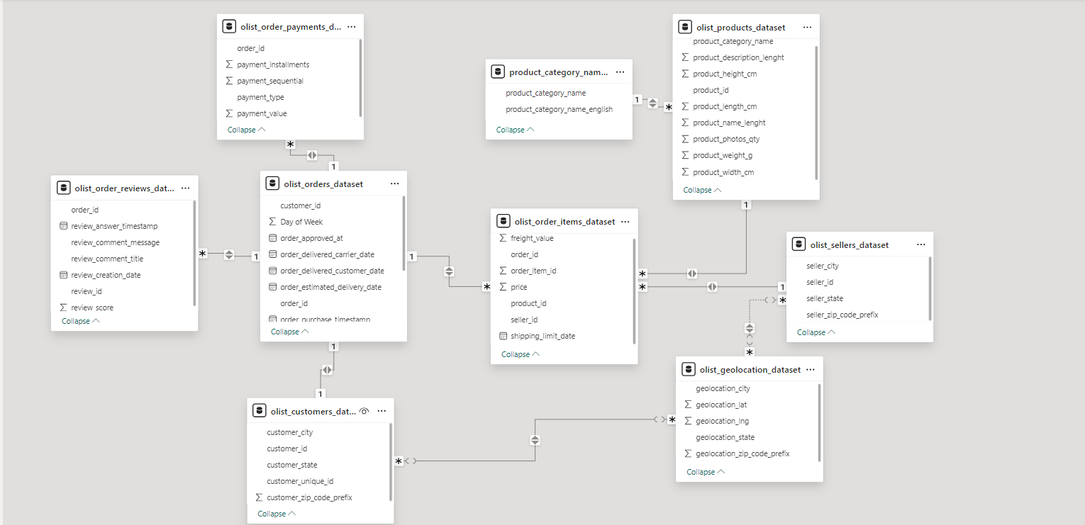
ModelView

Slide 6
The schema represents a relational data model for an e-commerce platform, where the datasets are connected based on key relationships:
olist_orders_dataset (Core Table):
Central table linking customer orders (order_id) to other datasets.
Customer and Location Data:
olist_customers_dataset: Contains customer demographics (e.g., city, state).
olist_geolocation_dataset: Maps zip codes to geographic locations (lat/lng).
Order Details:
olist_order_items_dataset: Tracks order items (product, seller, price, freight value).
olist_order_reviews_dataset: Captures customer reviews (ratings, comments) tied to orders.
olist_order_payments_dataset: Details payment types and values for each order.
Product and Seller Data:
olist_products_dataset: Product attributes (category, dimensions, weight).
product_category_name_translation: Translates product category names to English.
olist_sellers_dataset: Seller details (location, zip code).
Each dataset is linked by primary and foreign keys, ensuring data integrity and enabling comprehensive analysis of orders, products, customers, and sellers.

